Slide 1
Interpretation of Laboratory Data

Slide 2
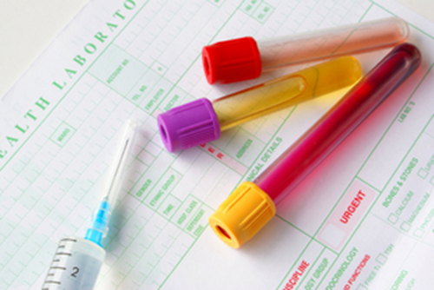
Introduction
Laboratory tests can provide useful information for clinicians for the diagnosis of a medical condition and for the monitoring of drug therapy (e.g., effect of an antibiotic therapy for a bacterial infection).
As a pharmacist, laboratory values can help select the most safe and appropriate therapy for patients, in addition to aid in the monitoring of the selected therapy.

Slide 3
The following caution is required while interpreting laboratory values:
Although laboratory errors are fairly uncommon, they do occur. Potential causes could include technical errors, sample contamination, timing in which the lab value was taken, i.e. trough levels should be drawn just prior to the next dose, and medication interference, i.e. Dopamine and dobutamine influence methods which use the Trinder reaction, thus affecting determination of glucose, cholesterol, and other tests.
2) Values shown in mmol/L units are equivalent to mEq/L units for some ions when valence is 1, like Hydrogen and Potassium. Otherwise mEq/L could be converted by multiplying mmol/L with valence.
3) Always treat the patient, never the laboratory value

Slide 4
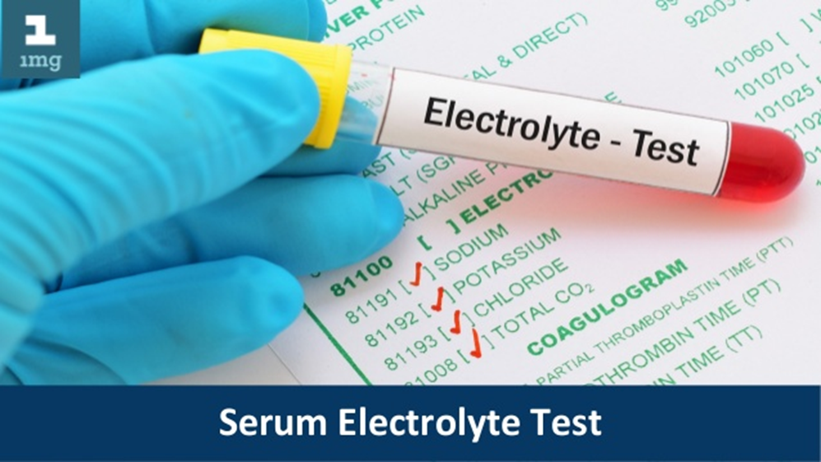
A) Electrolytes
Electrolytes and blood chemistries are important for maintaining acid-base and fluid balance.
They also play a vital role in nerve and muscle functioning.
These usually comprise of
Sodium
Potassium
Chloride
Calcium
Magnesium
Phosphate.

Slide 5
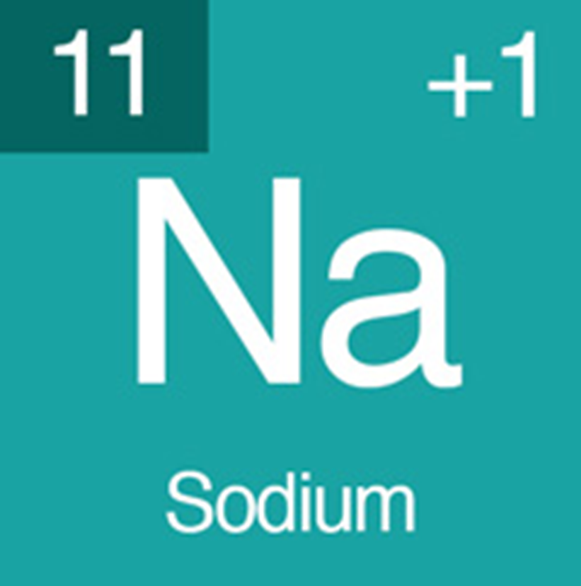
1) Sodium
Sodium is the most prevalent extracellular cation in the body.
Its primary function is to regulate the serum osmolality, fluid balance, and acid-base balance.
Measuring serum sodium values helps in assessing the patient’s electrolyte, water, and Acid-base balance. It also helps assess their renal function.
Normal values: 135-145 mEq/L.

Slide 6
Hyponatremia
Serum sodium of less than 135 mEq/L
Causes of hyponatremia may be
edema from a relative increase in free body water.
Certain drugs, like tricyclic antidepressants, loop and thiazide diuretics and antiepileptic drugs (e.g., carbamazepine, oxcarbazepine).

Slide 7
Hypernatremia
Serum sodium of >145 mEq/L
Often occurs as a result of dehydration or fluid loss, which could be due to conditions such as gastroenteritis, diarrhea, or Cushing’s syndrome.

Slide 8
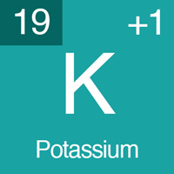
2) Potassium
Potassium is the main intracellular cation and plays a key role in many bodily functions including nerve excitability acid-base balance, and muscle function.
Normal values: 3.5-5 mEq/L.

Slide 9
Hypokalemia
K+ concentration < 3.5 mEq/L
Causes of hypokalemia include
Severe diarrhea
Alkalosis
Loop and thiazide diuretics
Insulin
Β-agonist (e.g., Albuterol, dobutamine)
Osmotic diuretics, like mannitol.

Slide 10
Hyperkalemia
K+ concentration >5 mEq/L
Causes of hyperkalemia include
Acidosis
Renal failure
Certain drugs, like angiotensin converting enzyme inhibitors (ACEIs)
Potassium sparing diuretics.

Slide 11
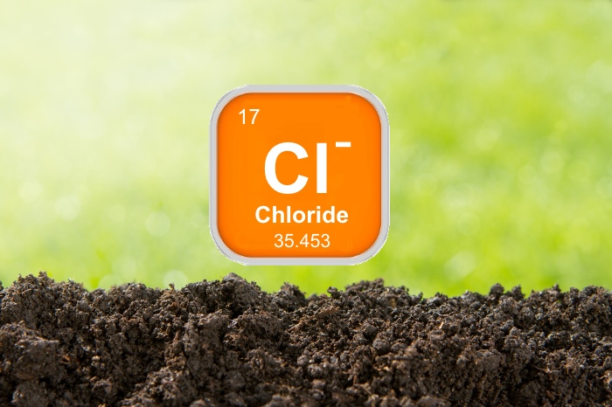
3) Chloride
Chloride is the principal extracellular anion which functions to serve a passive role in the maintenance of fluid balance and Acid-base balance, by having an inverse relationship with bicarbonate.
Normal values: 96 -106 mEq/L.
Any deviations in normal values are a sign of fluid or acid-base balance disorder, such as metabolic acidosis, respiratory alkalosis, or prolonged vomiting.

Slide 12
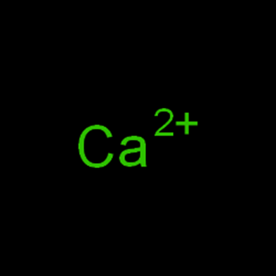
4) Calcium
Normal serum 8.5 - 10.5 mg/dL (includes ionized calcium and calcium bound to protein, primarily albumin, and ions)
Ionized calcium: 4.4-5.3 mg/dL
Normal levels maintained by hormonal regulation using skeletal reserves
Ionized calcium is more accurate, especially in patients with hypoalbuminemia; evaluate before repleting Ca2+

Slide 13
Hypocalcemia
Serum calcium <8.5 mg/dL; ionized Ca2+ <4.4 mg/dL
Causes of hypocalcemia :
Hypoalbuminemia
Hypoparathyroidism
Hypomagnesemia
Renal failure, renal tubular necrosis
Vitamin D deficiency or impaired metabolism

Slide 14
Hypercalcemia
serum calcium >10.5 mg/dL; ionized Ca2+ >5.3 mg/dL
Causes of hypercalcemia
Hyperparathyroidism
Some malignancies, especially breast, lung, kidney; multiple myeloma, leukemia, lymphoma
Medications: thiazide diuretics, lithium, vitamin A toxicity
Immobilization
Hyperthyroidism
Corrected Ca (mg/dL) = (4 – plasma albumin in g/dL) × 0.8 + serum calcium.

Slide 15
5) Phosphorus
Major intracellular anion; 85% of body stores found in bone
Reference range: 2.5 ‐ 4.5 mg/dL
Function
Muscle function
Bone formation
Cell membrane composition
Nerve conduction
Metabolism, adenosine triphosphate (ATP) production

Slide 16
Hypophosphatemia
Serum phosphate < 2.5 mg/dL
Etiology
Impaired absorption (diarrhea, Vitamin D deficiency, impaired metabolism)
Medications: phosphate binding antacids, sucralfate, insulin, steroids
Alcoholism, especially during withdrawal
Intracellular shifts in alkalosis, anabolism, neoplasms
Refeeding syndrome
Increased losses: hyperparathyroidism, renal tubular defects, DKA recovery, hypomagnesemia, diuretic phase of ATN

Slide 17
Hyperphosphatemia
Hyperphosphatemia (>4.5 mg/dL)
Causes of hyperphosphatemia
Decreased renal excretion: acute or chronic renal failure (GFR<20-25 mL/min);
hypoparathyroidism
Increased cellular release: tissue necrosis, tumor lysis syndrome
Increased exogenous phosphorus load or absorption, phosphorus containing laxatives or enemas, vitamin D excess
Acidosis

Slide 18
6) Magnesium (1.7–2.3 mg/dL)
Hypomagnesemia (serum magnesium concentration less than 1.7 mg/dL)
Decreased absorption: prolonged diarrhea, intestinal or biliary fistula, intestinal resection or bypass, steatorrhea, ulcerative colitis; upper GI fluid loss, gastric suctioning, vomiting
Renal losses: osmotic diuresis, DM with glucosuria, correction of DKA, renal disease with magnesium wasting, hypophosphatemia, hypercalcemia, hyperthyroidism
Alcoholism malnutrition
Intracellular shift: acute pancreatitis
Refeeding syndrome

Slide 19
Hypermagnesemia (serum magnesium greater than 2.3 mg/dL)
• Acute or chronic renal failure

Slide 20
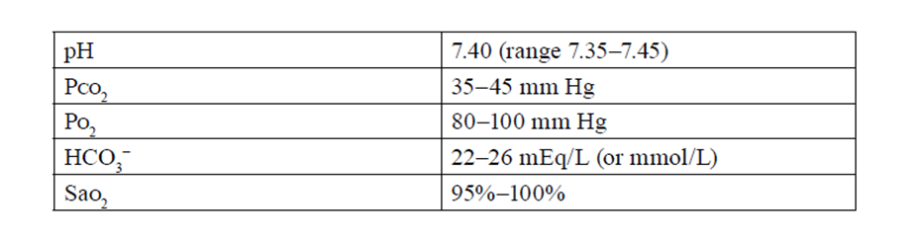
B) Blood Gas
Normal Arterial Blood Gas Values.

Slide 21
B. Acidosis: Any pH less than 7.35 indicates a primary acidosis.
C. Alkalosis: Any pH greater than 7.45 indicates a primary alkalosis.
D. Metabolic disorders
1. Acidosis: Decreased HCO3−
2. Alkalosis: Increased HCO3−
E. Respiratory disorders
1. Acidosis: Increased Pco2
2. Alkalosis: Decreased Pco2

Slide 22
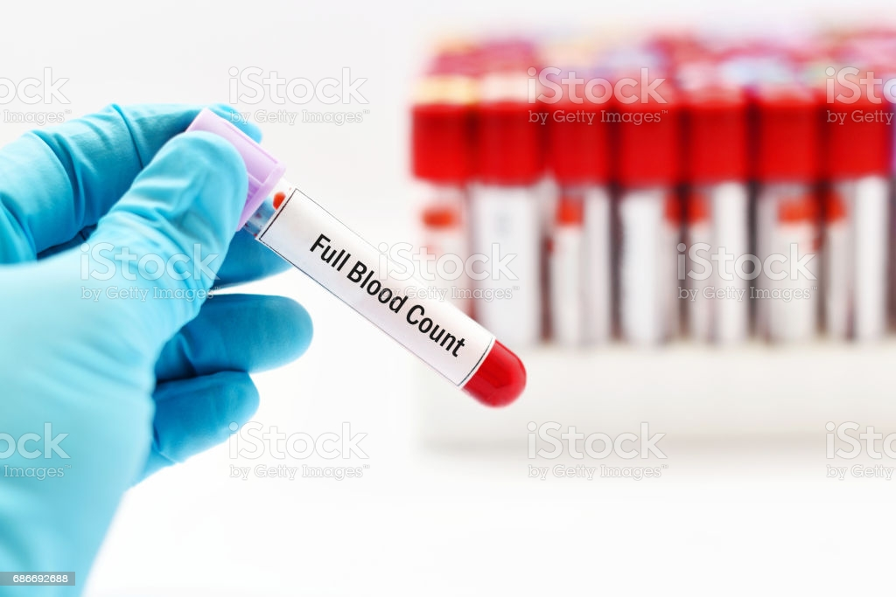
C) Hematology
Full Blood Count
Hemoglobin (hb)
Hematocrit (hct)
Red blood cell (RBC) count
White blood cell (WBC) count
WBC differential count
RBC morphology.
Notes:
There are some subtle differences in values between males and females for these measurements, and these need to be taken into consideration when interpreting the values.

Slide 23
1) Hemoglobin
Hemoglobin is the oxygen-carrying compound in the RBCs and is a direct indicator of the oxygen-carrying capacity of blood.
Increased Hb levels can be due to diseases such as chronic pulmonary lung disease or polycythemia vera.
It may also be increased in chronic smokers, those who live at high altitudes (due to low oxygen in air at higher altitudes), and those who engage in regular exercise.
The high carbon monoxide content in cigarette smoke prevents oxygen from binding to Hb, making the body interpret low Hb levels, and signal for increased RBCs production.
lower levels are an indication of anemia or hemorrhage.

Slide 24
2) Hematocrit
Hematocrit, also known as packed cell volume, describes the volume of blood occupied by RBCs.
It can also be used as an indicator of Hb, as hematocrit values are usually three times the value of Hb.
Similar to Hb, decreased values are an indication of anemia or hemorrhage.
The hematocrit can indicate if there is a problem with RBCs, but it cannot determine the underlying cause.

Slide 25
3) Red Blood Cell Count
RBCs serve to transport oxygen from the lungs to the body tissues.
They have a life span of approximately 120 days, before being cleared by the reticuloendothelial system.
In most laboratory reports, the results will examine
The number of cells per cubic mm
Size
Shape
Color

Slide 26
These can then be used to classify different types of anemia to pinpoint the etiology.
In general, they can be classified by the following:
RBC size or mean corpuscular volume (indicating average RBC size).
RBC color or mean corpuscular Hb concentration, which can be hypochromic, hyperchromic, and normochromic.
For example, microcytic, hypochromic anemia could be due to iron deficiency.

Slide 27
An increased level of RBCs is same as causes of Hb increase
Low RBC counts can be due to anemia, hemorrhage, or chronic renal failure.
There are several types of anemia:
Microcytic (iron deficiency anemia)
Macrocytic/megaloblastic anemia (vitamin B12 deficiency, folic acid deficiency)
Anemia of chronic disease (including chemotherapy-induced anemia), anemia of critical illness, hemolytic anemias, and drug-induced anemias.
B-12 vitamin deficiency causes pernicious anemia
pyridoxine or copper deficiency causes sideroblastic anemia.
Long term use of the oral hypoglycemic agent, metformin, has been linked with vitamin b12 deficiency.

Slide 28
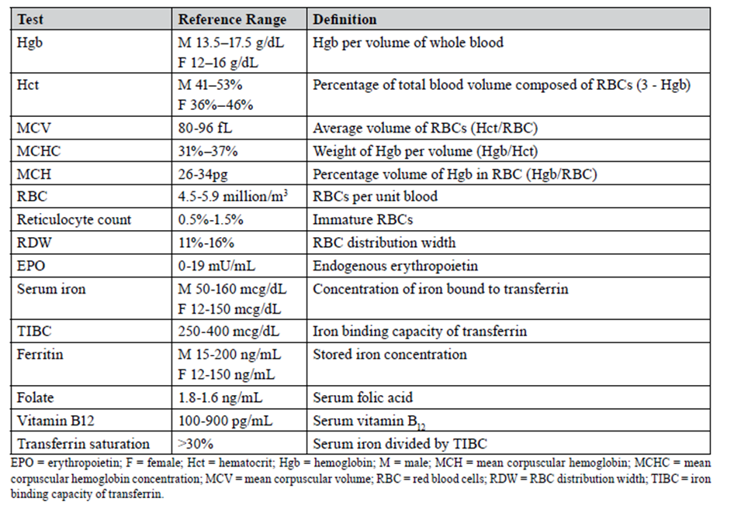
Hematologic Laboratory Values

Slide 29
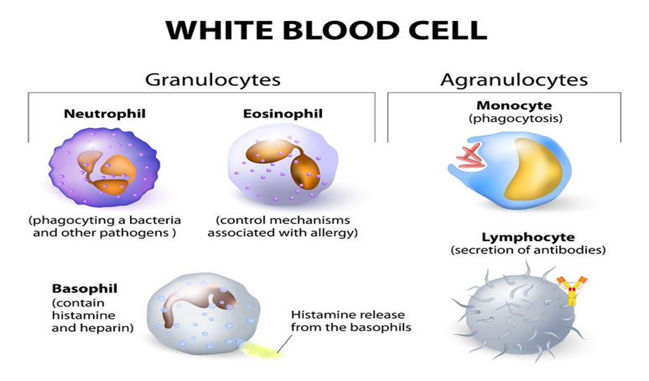
4) White Blood Cell Count
WBCs, or leukocytes, consist of five main types:

Slide 30
The WBC count is usually given with a breakdown of the percentage of each WBC type.
WBCs protect the body against foreign bodies and infection.
Neutrophils are the most abundant WBCs.
Normal value of WBCs is 4,500 -11,000 WBCs per microliter (4.5 to 11.0 × 109/L).
A low number of WBCs is called leukopenia
A higher than normal WBC count is called leukocytosis

Slide 31
Leukopenia may be due to:
Bone marrow deficiency or failure (for example, due to infection, tumor, or abnormal scarring)
Chemotherapeutic agents and other medicines as clozapine and captopril
Certain autoimmune disorders such as lupus (SLE)
Disease of the liver or spleen
Certain viral illnesses, such as mononucleosis (mono)

Slide 32
A higher than normal WBC count is called leukocytosis. It may be due to:
Certain drugs as lithium and Corticosteroids
Cigarette smoking
After spleen removal surgery
Infections, most often those caused by bacteria
Inflammatory disease (such as rheumatoid arthritis or allergy)
Leukemia or Hodgkin disease
Tissue damage (for example, burns)

Slide 33
leukocytosis is suggestive of an invading organism.
In general, the most commonly observed readings are the lymphocyte counts, as these are usually an indicator of viral infections.
Meanwhile, an increase in eosinophil levels is taken to be associated with allergic reactions and parasitic infections.
Neutrophil levels may rise due to drugs like steroids, infection, or intense exercise.

Slide 34
5) Platelets
Platelets are a critical element of blood clot formation.
They bind together when damaged blood vessels are recognized.
Normal values: 150,000-450,000/mL.
High levels of platelets (thrombocytosis) can be caused by infections and chronic inflammatory disorders, as well as iron deficiency anemia.
Decreased platelet counts (thrombocytopenia) may occur in patients with an autoimmune disorder, or while under chemotherapy, due to bone marrow suppression. Heparin can also cause an idiosyncratic reaction of low platelet counts called heparin-induced thrombocytopenia.

Slide 35
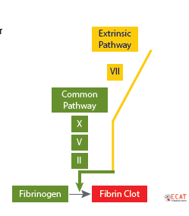
6)Prothrombin Time (PT)
The PT is used to assess deficiencies or inhibitors of the extrinsic pathway factors (Factor VII) and common pathway factors (Factors X, V, II, Fibrinogen).
Normal values: 9.5 - 13.5 seconds.

Slide 36
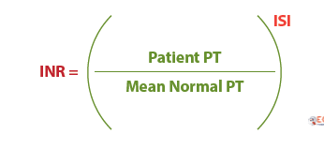
7) International Normalized Ratio (INR)
The International Normalized Ratio (INR) was developed to standardize the PT to allow for monitoring of oral vitamin K antagonist therapy (e.g. warfarin) across different labs.
Normal values: The reference range for INR should be less than 1.3.
An INR range of 2.0-3.0 is the target therapeutic range for most patients on anticoagulant therapy.

Slide 37
Some of the causes of a prolonged PT include anticoagulant therapy (e.g., warfarin).
Vitamin K deficiency can elevate the INR, and may occur due to malnutrition
biliary obstruction
malabsorption
use of certain broad-spectrum antibiotics (cephalosporins, metronidazole, macrolides, fluoroquinolones, penicillins, sulfonamides, and tetracyclines)
liver diseases (i.e., synthesis of clotting factors is diminished)
fibrinogen abnormalities (e.g., hypofibrinogenemia, afibrinogenemia, dysfibrinogenemia), or dilution of plasma clotting proteins after a blood transfusion.
azole antifungals are most likely to increase bleeding risk in older continuous users of warfarin.

Slide 38
A decreased PT can be caused by
vitamin K supplementation
high intake of food containing vitamin K (e.g., liver, broccoli, kale)
estrogen-containing drugs (e.g., contraceptive pills, hormone replacement therapy)
freshly frozen plasma transfusion.

Slide 39
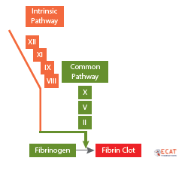
Activated Partial Thromboplastin Time (APTT)
The APTT is used to assess deficiencies or inhibitors of the intrinsic pathway factors (Factors XII, XI, IX, VIII) and common pathway factors (Factors X, V, II, Fibrinogen).

Slide 40


Slide 41
